Slide 1
An Empirical Study of AI Patents
Amy Semet
University of Buffalo School of Law

Slide 2
USPTO AI Database (2020)
Contain one or more of several AI technology components: machine learning, natural language processing, computer vision, speech, knowledge processing, AI hardware, evolutionary computation, and planning and control)
Machine learning (ML) approach that analyzed patent text and citations to identify AI in U.S. patent documents (Abood and Feltenberger 2018; Toole et al. 2020)
1976-2020 and pre-grant publications (PGPubs) published through 2020
AI model whether one of the categories based on text of patent, its claim and its citations (backward and forward)
12 million patent documents between 1976-2020 (abstract and claims) and backward and forward citations (US granted patents and apps only)
Knowledge processing, and planning and control have lower performance statistics than others
2018: 25% of patents are AI; mostly new entrants
Manual process: 4 examiners hand coding 400 documents each from selected group of about 600 documents
668,808 AI patents

Slide 3
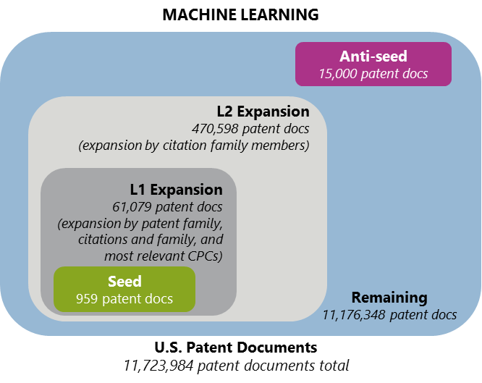
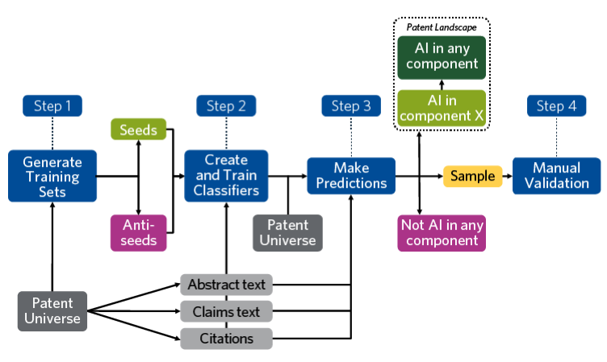
PTO Database: Process
Artificial Intelligence Patent Dataset (AIPD) Page 8 U.S. Patent and Trademark Office August 2021

Slide 4
Time Trends

Slide 5
AI Patents: Overall v. Litigated Patents

Slide 6
AI Plaintiffs

Slide 7
Substantive Outcomes and Procedural Postures
More likely to find AI patents invalid overall (driven by NLP, planning patents)
Especially on subject matter (especially planning patents) and definiteness
Obviousness higher for planning patents
Definiteness less likely for planning patents
Enablement for evolution, speech and NLP patents
No difference for anticipation
Less likely to find patent infringed (NLP, hardware) (except ML)
More likely to have a claim construction order
More likely to be disposed of by judgment on the pleadings and less likely to have a bench trial
More likely to be appealed (but not more likely to be affirmed or reversed)

