Slide 1
Executive Influence on Deportations: Immigration Court Decisions Across Recent Presidencies
Amy Semet
Associate Professor of Law
University of Buffalo School of Law

Slide 2
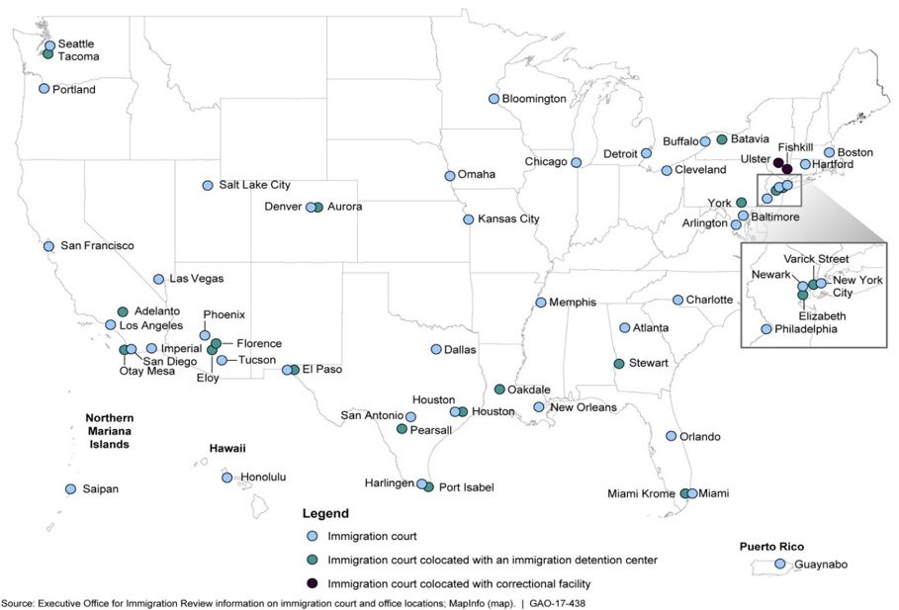

Slide 3
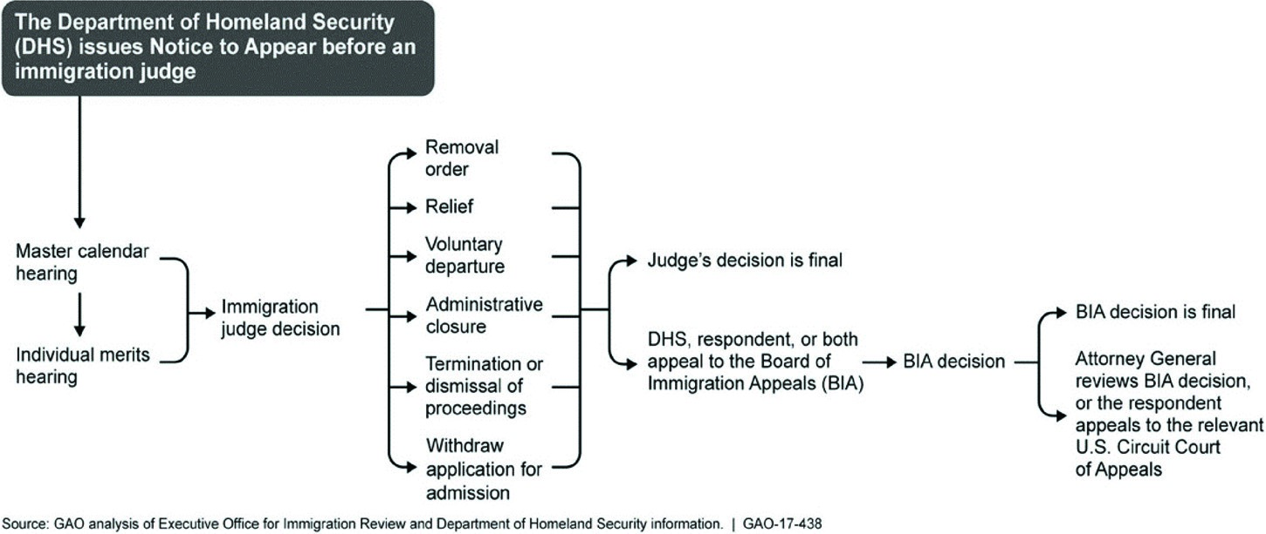

Slide 4
EOIR Database
Almost 14 million removal decisions in January 20, 2001 through February 28, 2026 decided by appointed IJs
Individual cases only: Limited to 3.5 million individual cases
Then limit it to first case on the merits: Limited to 2.6 million cases
Exclude
Rider cases/Juvenile cases
Stipulated cases
Cases decided by Carter, Nixon appointees or visiting judges not appointed
IJs who heard less than 50 proceedings or decisions by those who had not yet been appointed
In Absentia cases

Slide 5
Removal Outcomes

Slide 6
Hypotheses
Hypothesis 1: Persistent Ideological Effects: Immigration judges appointed by Republican presidents—particularly Trump-appointed judges—will exhibit systematically higher removal rates than judges appointed by Democratic presidents, even after controlling for case characteristics and institutional factors.
Hypothesis 2: Administrative Responsiveness: Removal rates will shift significantly across presidential administrations for all judges, reflecting changes in enforcement priorities, institutional signaling, administrative policy, and broader executive-branch environments.
Hypothesis 3: Conditional Cohort Responsiveness: Although all judges may respond to changing administrations, appointing-president cohorts will differ in the magnitude of their responsiveness. In particular, Trump-appointed judges may react differently during the Biden and Trump II eras relative to other appointment cohorts.

Slide 7
Removal Rates

Slide 8
Removal Rates: Active Judges

Slide 9
Removal Rate by Appointee and Era+
Controls+
Fixed Effect

Slide 10
Regression Analysis
Pr(Removal= 1) = Λ(α₀ + β₁Appointee/Administration₁+β₂Case₁+ β₃Immigration Judge₁ +ℇ)
Removal: 1st Decision in Individual Case, counting Removal=1 if Remove or Voluntary Departure; Removal=0 if Relief, Terminated or Dismissed. Alternatives: Last Case instead of First Case; also Removal=0 if Administrative Closure
Case: Represented by Lawyer, Nationality, English-speaking, Asylum, Complexity, Ever in Custody, Whether Hearing in Detention Facility, Video, Criminal, Priority Case Flag
IJ: Gender, Govt, Tenure, Military, Immigration Experience
Other: Judge, Court-Month
Missing or Incomplete Data: Family Ties, Job, Length of U.S. residence, Fixed U.S. address, Prior attempts to flee, Manner of entry, Complete Criminal History, Caselaw differences

Slide 11
Removal Rate by Appointee with Era+Controls

Slide 12
Removal Rate by Era with Appointee +Controls

Slide 13
Predicted Probabilities

Slide 14
Other Variables
Effects

Slide 15
Event Study: Trump I Transition

Slide 16
Event Study: Biden Transition

Slide 17
Event Study: Trump II Transition

Slide 18
Conclusion
Immigration adjudication appears strongly responsive to presidential administrations, suggesting that institutional and executive-branch environments meaningfully shape legal outcomes.
The attenuation of appointment-cohort effects after introducing judge and court-time fixed effects implies that system-wide administrative conditions may matter more than stable ideological differences among judges.
Because immigration judges operate within the executive branch, the findings raise concerns about the degree of adjudicative independence and the consistency of outcomes across administrations.
The results suggest that similarly situated noncitizens may experience materially different adjudicative environments depending on presidential administration, with important implications for fairness, uniformity, and legitimacy in immigration courts.

